Slide 1

Tutorial on Python
ENGG 818
Advanced Numerical Method
Fall 2022
Surya Pusapati

Slide 2
Table of content
Overview of python
Introduction to python
Essential Python packages for Numerical Methods

Slide 3
1.1 What is Python?
Python is a very popular general-purpose interpreted, interactive, object-oriented, and high-level programming language. Python is a dynamically-typed and garbage-collected programming language. It was created by Guide van Rossum during 1985-1990. Python source code is also available under GNU General Public License (GPL).

Slide 4
1.2 Why learn python?
Python is consistently rated as one of the world’s most popular programming languages*.
Python is open source which means it is available free of cost
Python is simple and so easy to learn
Python is versatile and can be used to create many different things
Python has powerful development libraries, including Artificial intelligence, Machine Learning, etc.
* From source https://www.tiobe.com/tiobe-index/python/

Slide 5
1.3 Properties of Python
Easy-to-learn
Easy-to-read
Easy-to-maintain
A broad standard library
Interactive Mode
Portable
Extendable
Databases
GUI Programming
Scalable
Object-Oriented Programming
Beginner’s Language

Slide 6
1.4 Python is primarily used by:
Game Developer
Web Designer
Python Developer
Full-stack Developer
Machine Learning Engineer
Data Scientist
Data Analyst
Data Engineer
DevOps Engineer
Software Engineer
Researcher
Professor

Slide 7
1.5 Python installation
Python is available for download at https://www.python.org/
Well-known Python IDE software:
Atom
IDLE
Jupyter Notebook
PyCharm
PyDev
Spyder
Thonny
Visual Studio Code

Slide 8
2. Introduction to python
Mode of Programming
Python Identifiers
Reserved Words
Lines and Indentation
Variable Assignment
Variable Types
List of built-in Methods
Basic Operators
Conditional Operators
Loop Statements
Files I/O
Functions
Python Modules

Slide 9
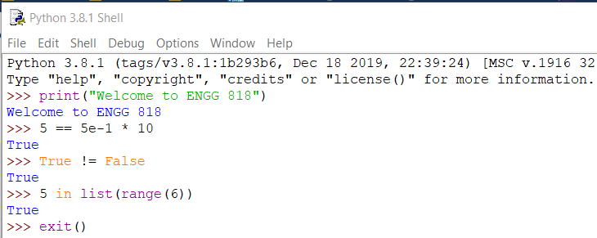
2.1 Mode of Programming
Interactive Mode Programming
A prompt with an active python interpreter without passing a script file as a parameter.

Slide 10
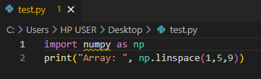
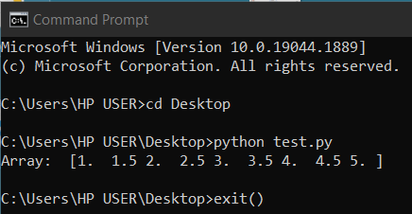
2.1 Mode of Programming
Script Mode Programming
The executed python script begins from the top and continues to the bottom until the script is finished.
Python files have extension .py

Slide 11
2.2 Python Identifiers
A python identifier is a name used to identify a variable, function, class module or other objects.
A python identifier can only start with the letter A to Z or a to z or an underscore (_) followed by letters, digits (0 to 9), and underscore.
Python does not allow punctuation characters such as @, $, and % within identifiers.
Python is a case-sensitive programming language. Thus, Xi and xi are two different identifiers.

Slide 12
2.3 Reserved Words
The following list shows the python keywords. All the keywords contain lowercase letters only. These words cannot be used as constant, variable, or other identifier names.
and
as
assert
break
class
continue
def
del
elif
else
except
exec
False
finally
for
from
global
if
import
in
is
lambda
none
nonlocal
not
or
pass
print
raise
return
True
try
while
with
yield

Slide 13
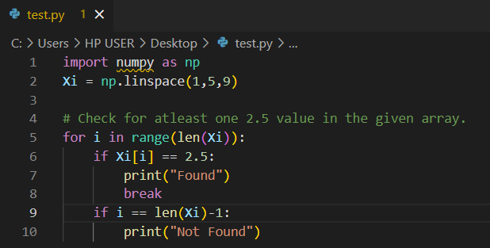
2.4 Lines and Indentation
Indentation
Python has no braces to indicate blocks of code for class and function definitions. It uses line indentation to separate blocks of code.
Tab space (8 character space) is used to separate blocks of code.

Slide 14
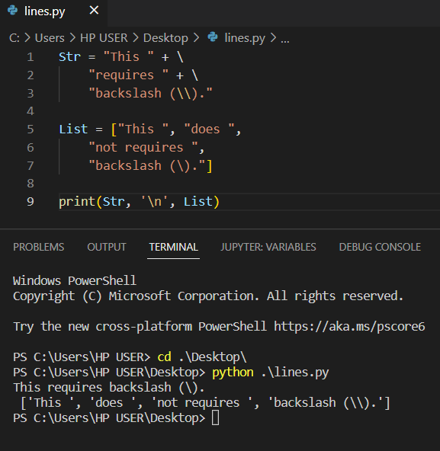
2.4 Lines and Indentation
Multi-line Statements
Statements in python typically end with a new line. To use a continuous line with new lines, backslash (\) can be used.
Statements containing [], {}, or () brackets do not require backslash.

Slide 15
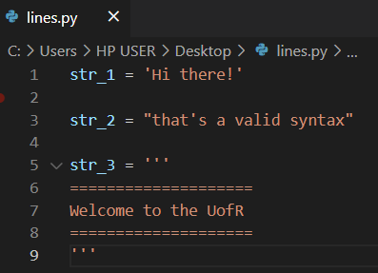
2.4 Lines and Indentation
Quotation in Python
Python uses single ('), double ("), and triple quotes (''' or """) to represent string literals.
The string syntax starts and ends with the same type of quote.
The triple quote is used especially for multi-line strings.

Slide 16
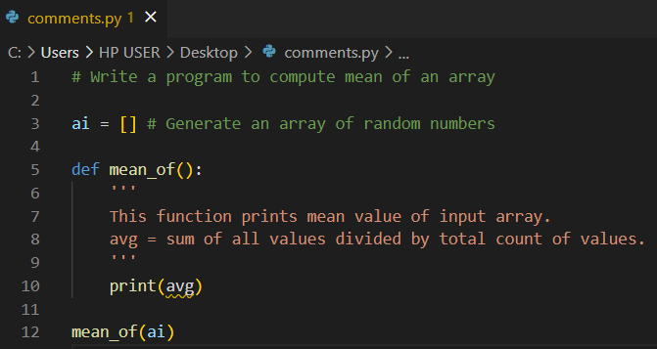
2.4 Lines and Indentation
Comments in Python
A hash sign (#) begins a comment syntax in python. The python interpreter will ignore any statements after #.
Triple quotes can be used for multi-line comments.

Slide 17
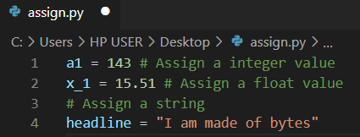
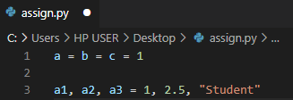
2.5 Variable Assignment
Equal to sign (=) is used to assign values to Variables.
Multiple value assignment is possible as follows.

Slide 18
2.6 Variable Types
Python has a wide range of built-in data types.
Function type() can be used to determine the data type.
The most commonly used data types are Numeric, Text, Sequence, and Dictionary data categories.
Python Number: int, float, complex
Python String: str
Python Sequence: list, tuple
Python Dictionary: dict

Slide 19
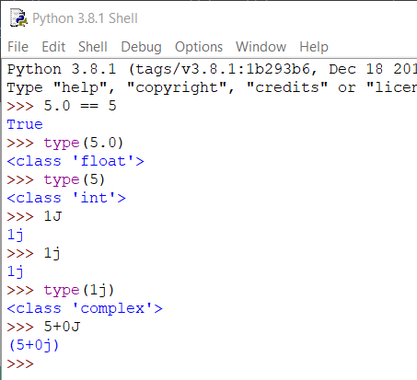
2.6 Variable Types
Python Number
Three types of numerical data types are accepted.
Integer is a whole number with positive and negative numbers, without decimal values.
Float is an integer with decimal values.
Complex is a complex number with “j” as the imaginary part.
Examples of int, float, complex data types are as follows.
int | float | complex
10 | 0.0 | 3.14j
100 | 14.80 | -.625+0j
-789 | -21.9 | 3e+26J
80 | 3.6e+5 | 1+1j
-253 | -50. | 0.5*(1+1j)

Slide 20
2.6 Variable Types
Python Number built-in methods
Method | Description
abs() | Returns absolute value
complex() | Converts data type into an complex number
float() | Converts data type into a floating point number
int() | Converts data type into an integer number
pow(x, y) | Returns x to the power of y value. Similar to x** y operation
pow(x, y, z) | Returns (x ** y) % z value
round(x, y) | Converts x to y decimal count(s)
.is_integer() | Returns True if the value is an integer
.real | Returns real component of the imaginary number
.imag | Returns imaginary component of the imaginary number
.conjugate() | Converts the sign of the imaginary component of the imaginary number

Slide 21
2.6 Variable Types
Python String
Strings in Python are identified as a set of characters represented in quotation marks.
Str data type is used to represent a string in python.
Syntax of python string is previously explained here.
Subsets of strings can be obtained using the slice operator ( [:] ).
The syntax of the slice operator is as follows [start:end:step]
Start and end are index values, whereas step is a consecutive selection of characters.

Slide 22
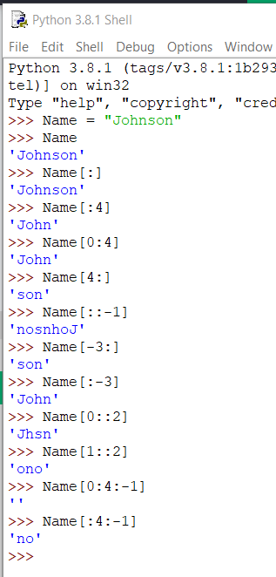
2.6 Variable Types
Python String slicing operator
Negative Index | -7 | -6 | -5 | -4 | -3 | -2 | -1
String | J | o | h | n | s | o | n
Index | 0 | 1 | 2 | 3 | 4 | 5 | 6

Slide 23
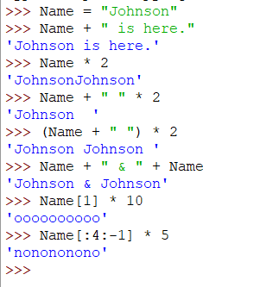
2.6 Variable Types
Python String other operators
The plus sign (+) for string concatenation.
The asterisk sign (*) for string repetition.
Here are some examples.

Slide 24
2.6 Variable Types
Python String built-in methods
Method | Description
len() | Returns count of characters in the string
str() | Converts data type into string
.capitalize() | Converts the first character to upper case
.casefold() | Converts string into lower case
.center() | Returns a centered string
.count() | Returns the number of times a specified value occurs in a string
.encode() | Returns an encoded version of the string
.endswith() | Returns true if the string ends with the specified value
.expandtabs() | Sets the tab size of the string
.find() | Searches the string for a specified value and returns the position of where it was found

Slide 25
2.6 Variable Types
Python String built-in methods
Method | Description
.format() | Formats specified values in a string
.format_map() | Formats specified values in a string
.index() | Searches the string for a specified value and returns the position of where it was found
.isalnum() | Returns True if all characters in the string are alphanumeric
.isalpha() | Returns True if all characters in the string are in the alphabet
.isdecimal() | Returns True if all characters in the string are decimals
.isdigit() | Returns True if all characters in the string are digits
.isidentifier() | Returns True if the string is an identifier
.islower() | Returns True if all characters in the string are lower case
.isnumeric() | Returns True if all characters in the string are numeric

Slide 26
2.6 Variable Types
Python String built-in methods
Method | Description
.isprintable() | Returns True if all characters in the string are printable
.isspace() | Returns True if all characters in the string are whitespaces
.istitle() | Returns True if the string follows the rules of a title
.isupper() | Returns True if all characters in the string are upper case
.join() | Joins the elements of an iterable to the end of the string
.ljust() | Returns a left justified version of the string
.lower() | Converts a string into lower case
.lstrip() | Returns a left trim version of the string
.maketrans() | Returns a translation table to be used in translations
.partition() | Returns a tuple where the string is parted into three parts

Slide 27
2.6 Variable Types
Python String built-in methods
Method | Description
.replace() | Returns a string where a specified value is replaced with a specified value
.rfind() | Searches the string for a specified value and returns the last position of where it was found
.rindex() | Searches the string for a specified value and returns the last position of where it was found
.rjust() | Returns a right justified version of the string
.rpartition() | Returns a tuple where the string is parted into three parts
.rsplit() | Splits the string at the specified separator, and returns a list
.rstrip() | Returns a right trim version of the string
.split() | Splits the string at the specified separator, and returns a list
.splitlines() | Splits the string at line breaks and returns a list
.startswith() | Returns true if the string starts with the specified value

Slide 28
2.6 Variable Types
Python String built-in methods
Method | Description
.strip() | Returns a trimmed version of the string
.swapcase() | Swaps cases, lower case becomes upper case and vice versa
.title() | Converts the first character of each word to upper case
.translate() | Returns a translated string
.upper() | Converts a string into upper case
.zfill() | Fills the string with a specified number of 0 values at the beginning

Slide 29
2.6 Variable Types
Python List
List is a most versatile datatype, which can be created as a list of comma-separated values (items) between square brackets ( [] )
list data type is used to represent list in python
List accepts items of any data type
List items are ordered, changeable, and allow duplicate values

Slide 30
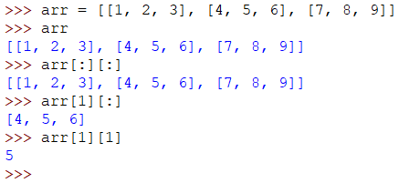
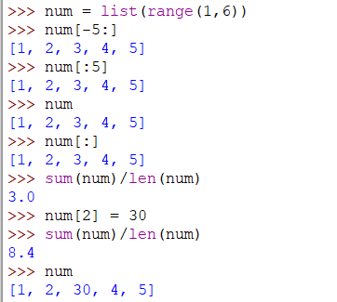
2.6 Variable Types
Examples of python List

Slide 31
2.6 Variable Types
Python List built-in methods
Method | Description
cmp(list1, list2) | Compares elements of both lists
len() | Returns count of elements in list
list() | Converts data type into list
max() | Returns item from the list with maximum value
min() | Returns item from the list with minimum value
.append() | Adds an element at the end of the list
.clear() | Removes all the elements from the list
.copy() | Returns a copy of the list
.count() | Returns the number of elements with the specified value
.extend() | Add the elements of a list (or any iterable), to the end of the current list

Slide 32
2.6 Variable Types
Python List built-in methods
Method | Description
.index() | Returns the index of the first element with the specified value
.insert() | Adds an element at the specified position
.pop() | Removes the element at the specified position
.remove() | Removes the item with the specified value
.reverse() | Reverses the order of the list
.sort() | Sorts the list

Slide 33
2.6 Variable Types
Python Tuple
Tuple can be created as a list of comma-separated values (items) between round brackets ()
tuple data type is used to represent tuple in python
Tuple accepts items of any data type
Tuple items are ordered and unchangeable

Slide 34
2.6 Variable Types
Python Tuple build-in methods
Method | Description
tuple() | Converts data type to tuple
.count() | Returns the number of times a specified value occurs in a tuple
.index() | Searches the tuple for a specified value and returns the position of where it was found

Slide 35
2.6 Variable Types
Python Dictionary
Dictionary can be created as a pair of key: value between round brackets ( {} )
dict data type is used to represent dictionary in python
Dictionary accepts items of any data type
Dictionary items are ordered, changeable, and do not allow duplicates
examples

Slide 36
2.6 Variable Types
Python Dictionary built-in methods
Method | Description
dict() | Converts data type into dictionary
.clear() | Removes all the elements from the dictionary
.copy() | Returns a copy of the dictionary
.fromkeys() | Returns a dictionary with the specified keys and value
.get() | Returns the value of the specified key
.items() | Returns a list containing a tuple for each key value pair
.keys() | Returns a list containing the dictionary's keys
.pop() | Removes the element with the specified key
.popitem() | Removes the last inserted key-value pair

Slide 37
2.6 Variable Types
Python Dictionary built-in methods
Method | Description
.setdefault() | Returns the value of the specified key. If the key does not exist, insert the key with the specified value
.update() | Updates the dictionary with the specified key-value pairs
.values() | Returns a list of all the values in the dictionary

Slide 38
2.7 List of built-in Methods
abs()
all()
any()
ascii()
bin()
bool()
bytearray()
bytes()
callable()
chr()
classmethod()
compile()
complex()
delattr()
dict()
dir()
divmod()
enumerate()
eval()
exec()
filter()
float()
format()
frozenset()
getattr()
globals()
hasattr()
hash()
help()
hex()
id()
input()
int()
isinstance()
issubclass()
iter()
len()
list()
locals()
map()
max()
memoryview()
min()
next()
object()
oct()
open()
ord()
pow()
print()
property()
range()
repr()
reversed()
round()
set()
setattr()
slice()
sorted()
staticmethod()
str()
sum()
super()
tuple()
vars()
zip()

Slide 39
2.8 Basic Operators
Operators are the constructs which can manipulate the value of operands.
Types of operators:
Arithmetic Operators
Comparison (Relational) Operators
Assignment Operators
Logical Operators
Bitwise Operators
Membership Operators
Identity Operators

Slide 40
2.8.1 Arithmetic Operators
Operator | Description | Example
+ | Addition: Adds values on either side of the operator | a = 10, b = 20 a + b = 30
- | Subtraction: Subtracts values on either side of the operator | a - b = -10
* | Multiplication: Multiplies values on either side of the operator | a*b = 200
/ | Division: Divides left hand operand by right hand operand | b/a = 2
% | Modulus: Divides left hand operand by right hand operand and returns reminder | b%a = 0
** | Exponent: Performs exponential (power) calculation on operators | a**b = 10^20
// | Floor Division: Return absolute value of division operator | b//a = 2

Slide 41
2.8.2 Comparison (Relational) Operators
Operator | Description | Example
== | Equal to: If values of two operands are equal, then the condition becomes true | a = 10, b = 20 a == b False
!= | Not equal to: If values of two operands are not equal, then the condition becomes true | a != b True
> | Greater than: If the value of left operand is greater than the value of right operand, then the condition becomes true | a > b False
< | Less than: If the value of left operand is less than the value of right operand, then the condition becomes true | a < b True
>= | Greater than or equal to: If the value of left operand is greater than or equal to the value of right operand, then the condition becomes true | a >= b False
<= | Less than or equal to: If the value of left operand is less than or equal to the value of right operand, then the condition becomes true | a <= b True

Slide 42
2.8.3 Assignment Operators
Operator | Description | Example
= | Assign value from right side operands to left side operand | c = a + b assigns value if a + b into c
+= | Add AND: adds right operand to the left operand and assigns the result to left operand | c += a is equivalent to c = c + a
-= | Subtract AND: subtracts right operand to the left operand and assigns the result to left operand | c -= a is equivalent to c = c - a
*= | Multiply AND: multiplies right operand to the left operand and assigns the result to left operand | c *= a is equivalent to c = c * a
/= | Divide AND: divides right operand to the left operand and assigns the result to left operand | c /= a is equivalent to c = c / a
%= | Modulus AND: performs reminder of divide operator and assigns the result to left operand | c %= a is equivalent to c = c % a
**= | Exponent AND: performs exponential (power) calculations on two operands and assigns the result to left operand | c **= a is equivalent to c = c ** a
//= | Floor Division AND: performs floor division on two operands and assigns the result to left operand | c //= a is equivalent to c = c // a

Slide 43
2.8.4 Logical Operators
Operator | Description | Example
and | Logical AND: if both the operands are true then condition becomes true | a and b True
or | Logical OR: if any of the two operands are non-zero then condition becomes true | a or b False
not | Logical NOT: Used to reverse the logical state of its operand | not(True) False

Slide 44
2.8.5 Bitwise Operators
Operator | Description | Example
& | Binary AND: Performs AND logical operation bit by bit | a = 0011 1100 b = 0000 1101 a&b = 0000 1100
| | Binary OR: Performs OR logical operation bit by bit | a|b = 0011 1101
^ | Binary XOR: Performs XOR logical operation bit by bit | a^b = 0011 0001
~ | Binary Ones Complement: Performs NOT logical operation bit by bit | ~a = 1100 0011
<< | Binary Left Shift: values are moved left by the number of bits specified by the right operand | a<<2 = 1111 0000
>> | Binary Right Shift: values are moved right by the number of bits specified by the right operand | a>>2 = 0000 1111

Slide 45
2.8.6 Membership Operators
Operator | Description | Example
in | Evaluates to true if it finds a variable in the specified sequence and false otherwise | 3 in [1, 3, 5] True
not in | Evaluates to true if it does not finds a variable in the specified sequence and false otherwise | 4 not in [1, 3, 5] True
2.8.7 Identity Operators
Operator | Description | Example
is | Evaluates to true if the variables on either side of the operator point to the same object and false otherwise | [1, 3, 5] is [1, 3, 5] True
is not | Evaluates to false if the variables on either side of the operator point to the same object and true otherwise | [0, 3, 5] is not [1, 3, 5] True

Slide 46
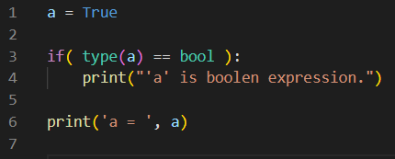
2.9 Conditional Operators
if statement
Decision making in python is performed by if conditional operator.
Condition
False
True
Block of code
if condition example

Slide 47
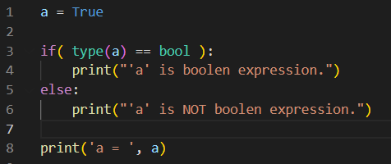
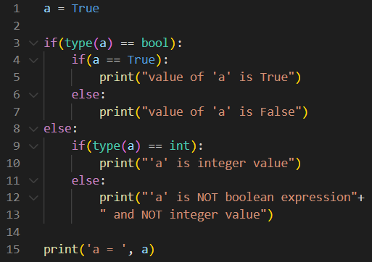
2.9 Conditional Operators
Condition
False
True
Block of code
Block of code
if else condition example
False
Condition
True
False
Condition
True
False
Condition
True
Block of code
Block of code
Block of code
Block of code
Nested if condition example 01

Slide 48
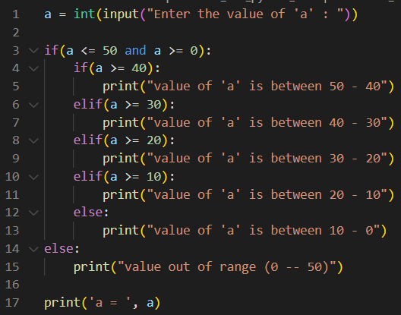
2.9 Conditional Operators
False
Condition
True
Block of code
False
Condition
True
False
Condition
True
Block of code
False
Condition
True
Block of code
False
Condition
True
Block of code
Block of code
Block of code
Nested if condition example 02

Slide 49
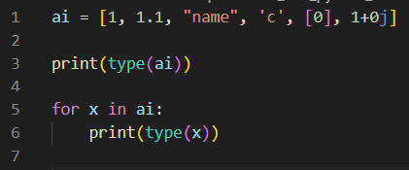
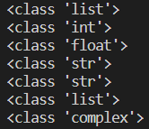
2.10 Loop Statements
for loop
for statement has the ability to iterate over the items of any sequence, such as a list or a string.
Item from Sequence
Block of code
for loop example

Slide 50
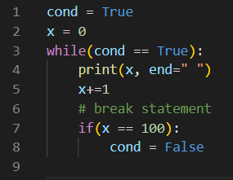

2.10 Loop Statements
while loop
while statement repeatedly executes a target statement as long as a given condition is true
Condition
Block of code
while loop example

Slide 51
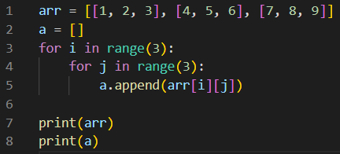

2.10 Loop Statements
nested loops
Intending a loop inside another loop is allowed in python
Item from Sequence
Item from Sequence
Block of code
Nested for loop example

Slide 52
2.10 Loop Statements
Loop Control Statements
Statements | Description
break | Terminates the loop statement and transfers execution to the statement immediately following the loop
continue | Causes the loop to skip the remainder of its body and immediately retest its condition prior to reiterating
pass | Used when a statement is required syntactically but you do not want any command or code to execute

Slide 53
2.11 Files I/O
The open(file, mode) function performs file handling in python.
In the syntax, the file specifies the directory and file name. The mode has the following string options on the file accessed.
Mode | Description
"r" | Read: Default value. Opens a file for reading.
"a" | Append: Opens a file for appending and creates the file if it does not exist.
"w" | Write: Opens a file for writing, creates the file if it does not exist.
"x" | Create: Create the specified file and return s an error if the file exists.
"t" | Text Mode: In addition to the above options, the file data type can be specified.
"b" | Binary Mode: In addition to the above options, the file data type can be specified.
"+" | Additional Mode: In addition to the above options, both the first specified mode and reading modes are enabled.

Slide 54
2.11 Files I/O
open() built-in methods
Method | Description
.closed | Returns true if file is closed, false otherwise
.mode | Returns access mode with which file was opened
.name | Returns name of the file
.softspace | Returns false if space explicitly required with print, true otherwise
.close() | Close the file
.write() | Write string into the file
.read() | Read the content of the file
.tell() | Returns current position within the file
.seek() | Change the position within the file

Slide 55
2.12 Functions
Defining a function
A function is a block of organized, reusable code to perform a single, related action.
A user-defined function can be created in python by using the keyword def followed by the function name, parentheses ( () ) and colon (:).
The first statement of a function can be a documentation string called a docstring.
The return statement exits a function. Optionally the function can be exited by indentation.

Slide 56
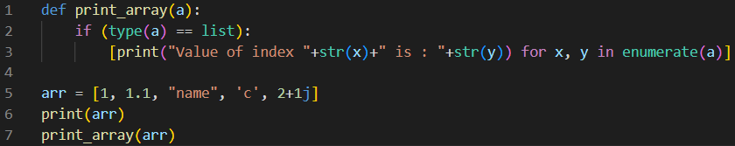
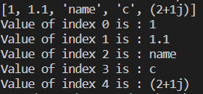
2.12 Functions
Example of python function
function example 01

Slide 57
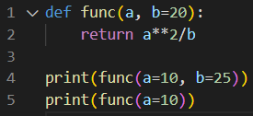
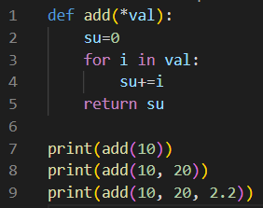


2.12 Functions
Example of python function
function example 02
function example 03

Slide 58
2.12 Functions
Function Arguments
Arguments | Description | Example
Required Arguments | Arguments passed to a function in correct positional order | print_array()
Keyword Arguments | Arguments passed to a function by the parameter name | func(a=10, b=25)
Default Arguments | An optional arguments which assigns default values incase of argument not passed | func(a=10)
Variable-length Arguments | An optional arguments with defined code when assigned. It has arguments beginning with *args or **kwargs | add()

Slide 59


2.12 Functions
lambda (Anonymous) Function
Lambda functions are called anonymous as they are not declared in the standard manner by using the def keyword.
function example 04

Slide 60
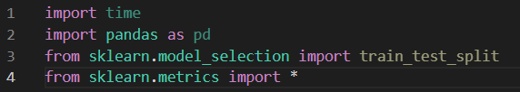
2.13 Python Modules
A module allows you to logically organize your python code. Grouping related code into a module males the code easier to understand and use. A module is a Python object with arbitrarily named attributes that you can bind and reference.
Importing modules

Slide 61
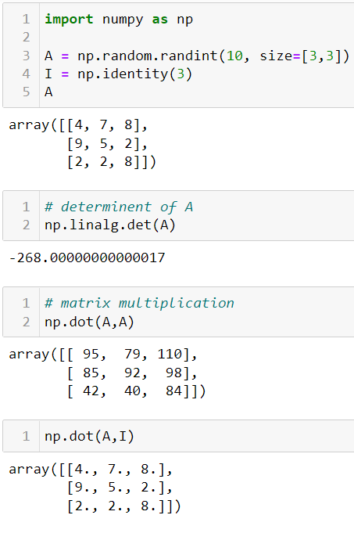
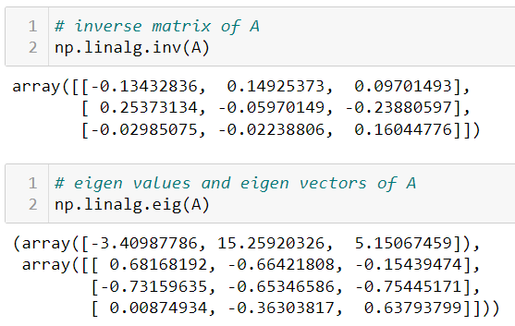
2.13 Python Modules
Example of modules usage

Slide 62
2.13 Python Modules
Packages in Python
A package is a hierarchical file directory structure that defines a single Python application environment that consists of modules and sub packages and sub-sub packages.
Search for Python Packages
PyPi: Python Package Index.
Available online at: https://pypi.org/

Slide 63
3. Essential Python packages for Numerical Methods
Python combined with Numpy, Scipy, Matplotlib, and Pandas can be used as a complete replacement for MATLAB.
Python
MATLAB
Pandas
Matplotlib
SciPy
NumPy
Python vs MATLAB
Kong, Q., Siauw, T., & Bayen, A. (2020). Python Programming and Numerical Methods: A Guide for Engineers and Scientists. Academic Press. Available online at: https://pythonnumericalmethods.berkeley.edu/notebooks/Index.html

Slide 64
3. Essential Python packages for Numerical Methods
NumPy is a module which provides the basic data structures, implementing multi-dimensional arrays and matrices. Besides that, the modules supply the necessary functionalities to create and manipulate these data structures.
Matplotlib is a plotting library for the Python programming language and numerically oriented modules like NumPy and SciPy. The youngest child in this family of modules is Pandas.
Pandas is using all of the previously mentioned modules. It’s built on top of them to provide a module for the Python language, which is also capable of data manipulation and analysis. The special focus of Pandas consists in offering data structures and operations for manipulating numerical tables and time series. The name is derived from the term "panel data.” Pandas is well suited for working with tabular data as it is known from spreadsheet programming like Excel.
SciPy is based on top of NumPy; it uses the data structures provided by NumPy. It extends the capabilities of NumPy with additional useful functions for minimization, regression, Fourier-transformation and many others.

